Slide 1
Class title
Topic

Slide 3
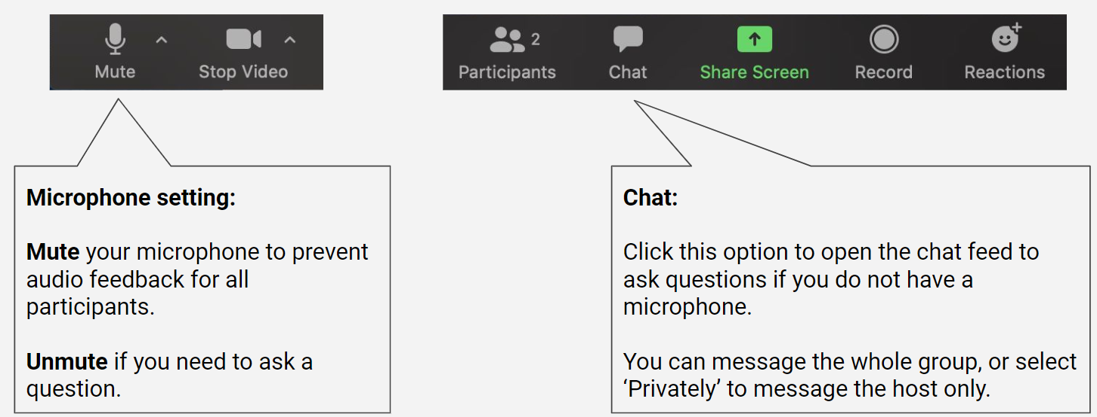
Participating via Zoom

Slide 4
Zoom expectations
Bold and highlight your expectations for the session as seen in the example below
Cameras
Off
User preference
On when speaking
Mostly on
Microphone
Muted unless speaking
User preference
Dialog
Raise hand to speak
Free flow
Chat
Please contribute to discussion with chat
Use Chat for questions
Multitasking
As needed
Limited
None: focus on the meeting
Adapted from: https://er.educause.edu/articles/2022/5/a-dx-roadmap-for-leading-the-new-hybrid-it-workforce Images: Роман Ярощук

Slide 5
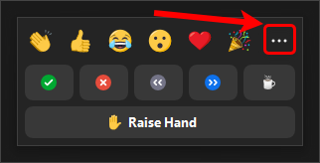
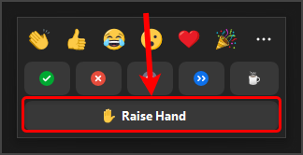
Using reactions
Click on the Reactions button to access a range of reactions which you can select during the meeting.
Click on the … button to view additional options.
The Raise Hand button can be used if you want to ask a question.

Slide 6
Using reactions
OR
Have your students respond to simple Yes or No questions using these reactions.
Ask students to respond with a Raise Hand if they agree with what you have said.

Slide 7
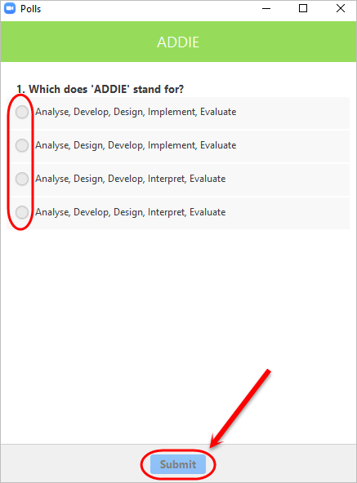
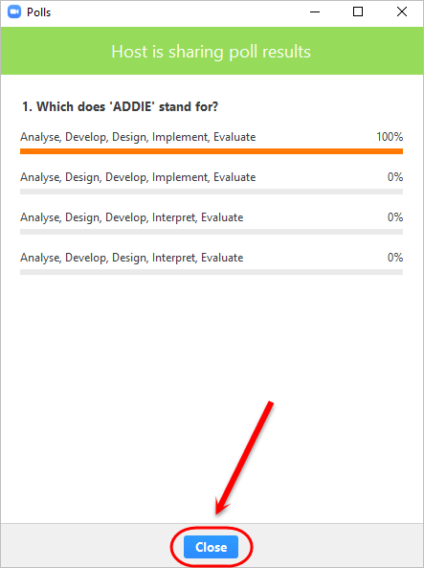
Participate in a poll
Respond to a poll by selecting your answer/answers and clicking on the Submit button.
Click on the Close button after reviewing the results.

Slide 8
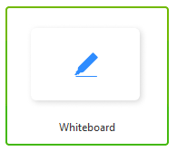
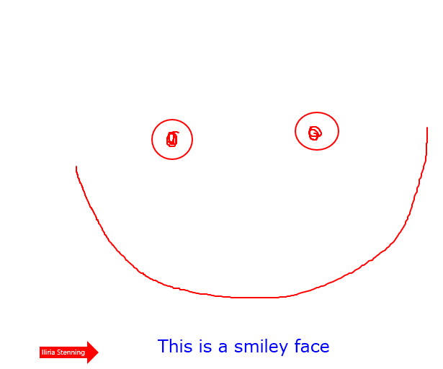
Share a whiteboard

Slide 9
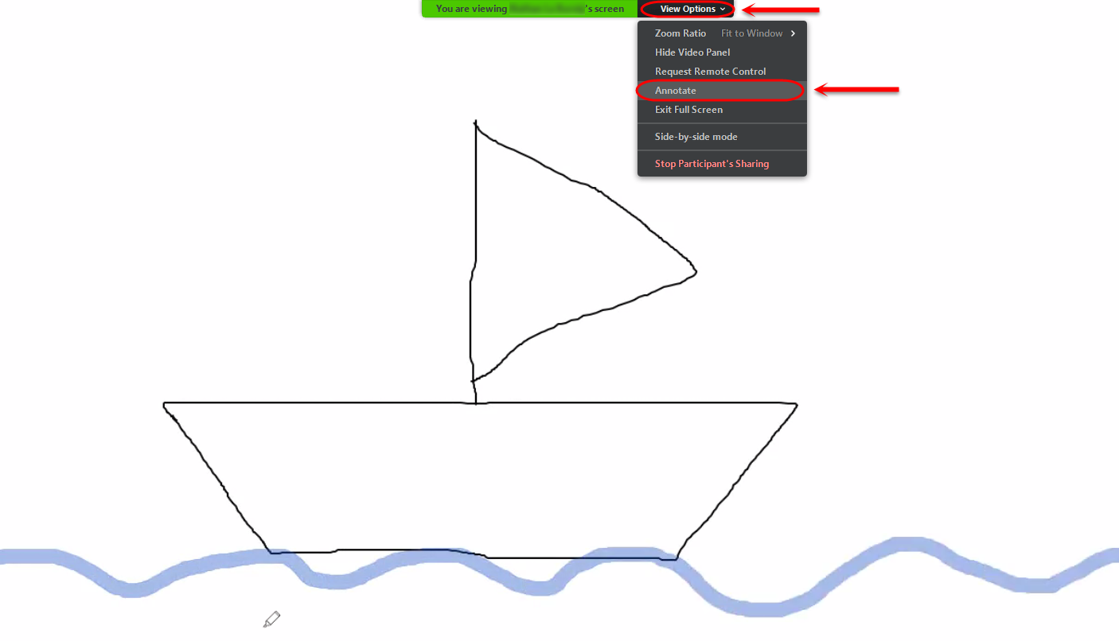
Contribute to a whiteboard

Slide 10
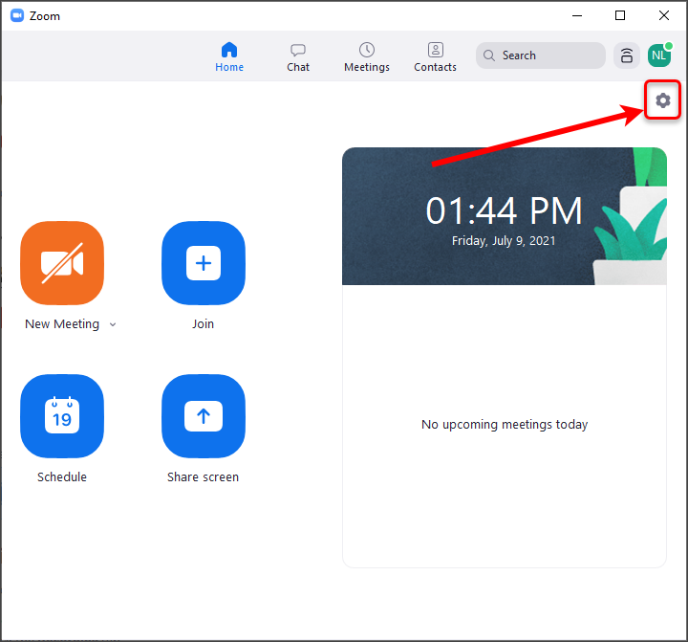
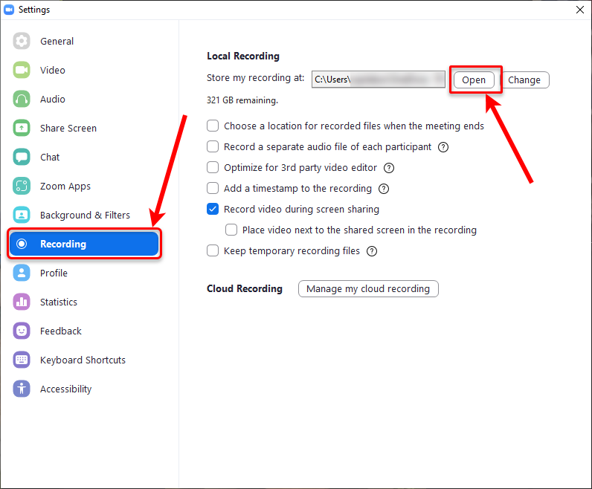
Locating your saved whiteboards
3. Select folder that matches meeting date and time
1. Open settings
2. Click on Recording → Open

Slide 11
Reaction icons
Note: all other available reactions have a maximum viewing duration of 10 seconds.

Slide 12
Question title
Insert question here
OR

Slide 13
Question title
Insert question here
OR

Slide 14
Question title
Insert question here
OR

Slide 15
Question title
Insert question here
OR

Slide 16
Example: What is the capital of Australia?
Sydney
Canberra
Melbourne
Perth

Slide 17
Thank you
Presenter name
Website
Email address

