Slide 1
UQ Course Site Design Guidelines
Enhanced
Recommended
Guidelines
Enhancements

Slide 2
Course banner
Welcome video
Optimised and consistent menu structure
Welcome message
Notes:
[CLICK] The optimised menu structure appears consistently in every course.
[CLICK] There is a course banner which has been created using the banner tool within Blackboard. This reinforces for the student which course they are currently looking at
[CLICK] There’s also a friendly welcome message that has been developed by editing the template message content.
[CLICK] You could also include a short welcome video by the lecturer providing an overview of the course and the benefits of taking it.

Slide 3
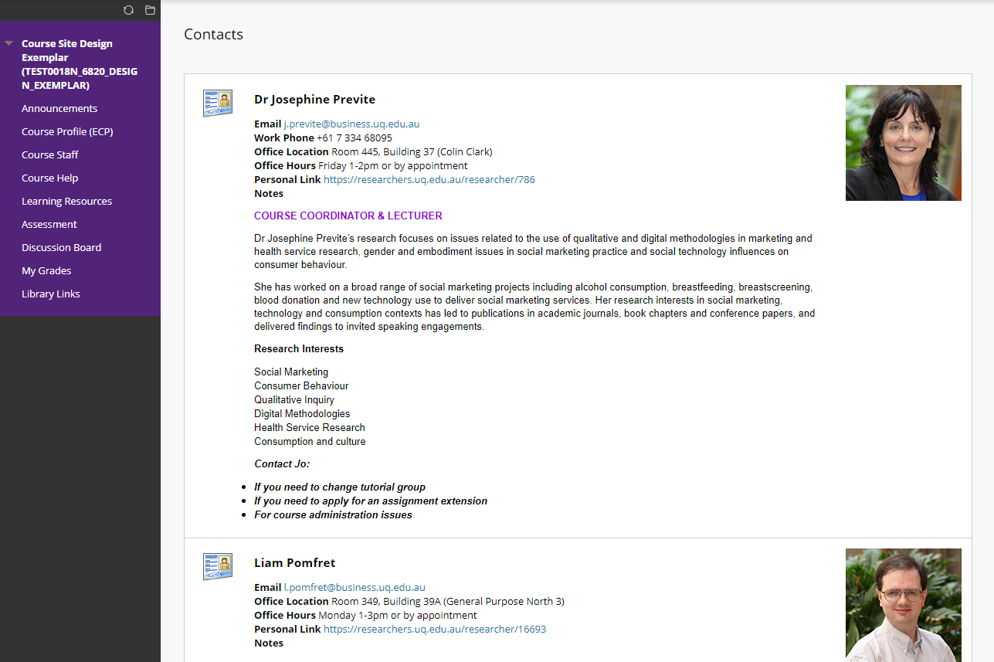
Course Coordinator at the top
Brief biography
Reasons to contact the Course Coordinator
Photos of all staff with contact details
Notes:
The Course Staff tab provides information and contact details about the Teaching Team.
[CLICK] The Course Coordinator should always be at the top,
[CLICK] and there should also be information on the reasons for students to contact them.
[CLICK] The contact details of other staff with their photos should be below, and this can include guest lecturers if you choose. These additional contacts can also be organised into a folder.
[CLICK] You may also wish to provide brief biographies of key members of the team.

Slide 4
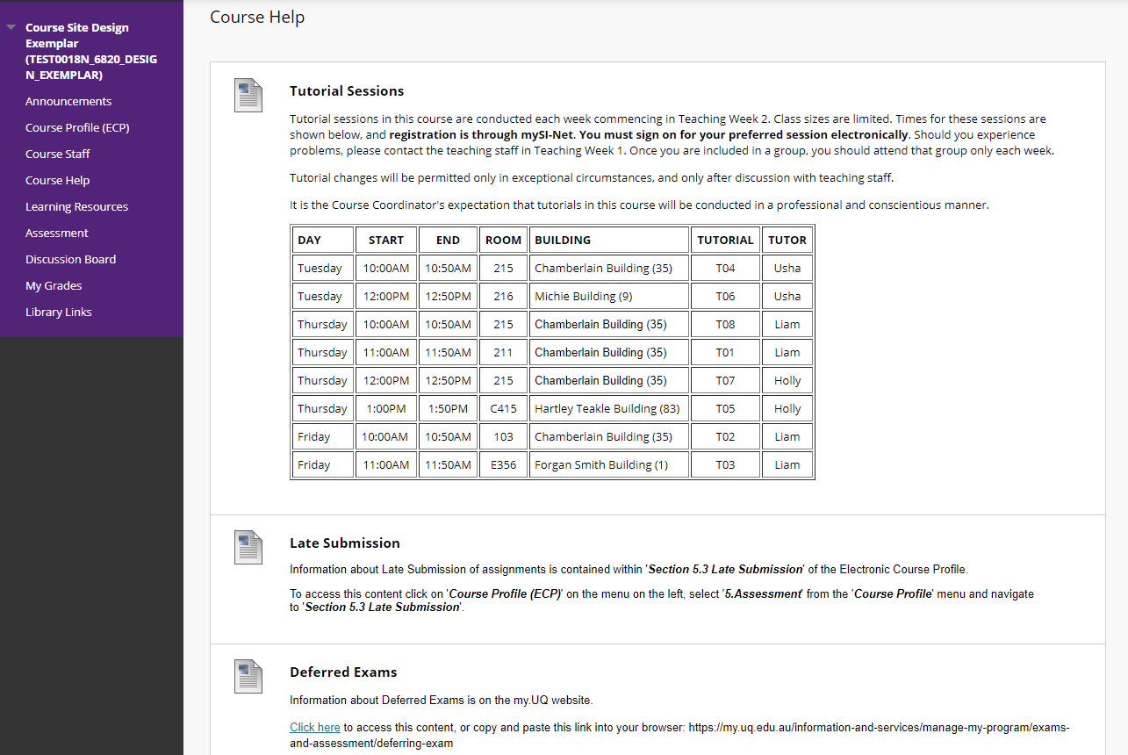
Consultation Schedule
Reference to ECP to avoid content duplication
Provide links or references to sources of help as appropriate
Reference to my.UQ website
Notes:
Course Help should be the first place that students are directed with questions. Providing students with clear directions of how to access support can improve their experience and minimise misdirected or unanswered questions.
[CLICK] Where possible, links or references to sources of help should be provided without duplicating content that can be found elsewhere.
[CLICK] To avoid content duplication, the Late Submission item is a reference to the relevant section of the course’s ECP,
[CLICK] while the Deferred Exams item has a link to the my.UQ section on the University’s Deferred Exams policy.
[CLICK] As tutors are often the main point of contact for students, you may choose to post a Consultation Sessions timetable.

Slide 5
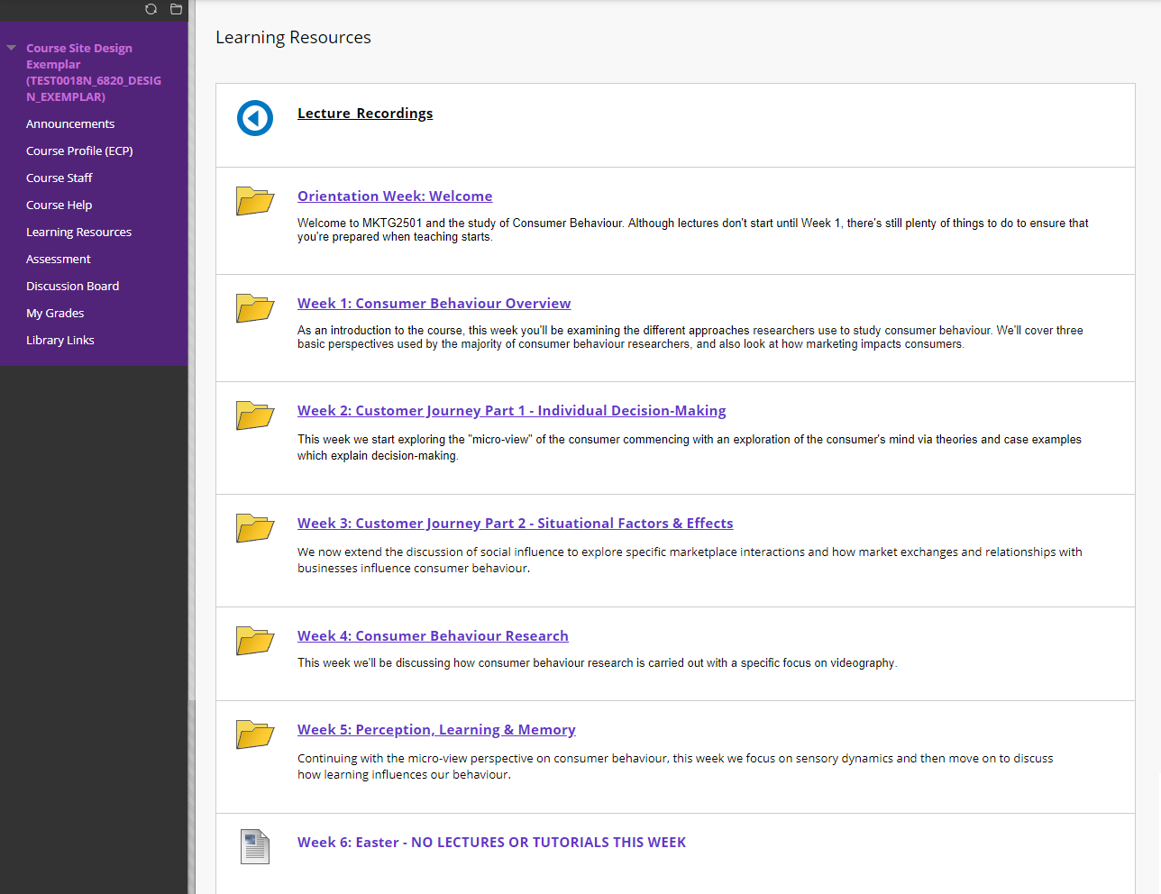
Lecture Recordings link at the top
Separate folder for each week or module
Overview of content for the week
Indication of schedule variations
Notes:
The Learning Resources section is organised to make it as easy as possible for students to find the resources the need.
[CLICK] The Lecture recordings folder should always be at the top, and the recordings are automatically added.
[CLICK] Below that are folders containing all the resources for each week of Semester. If your course requires, this could equally be separate folders for each module.
[CLICK] Below the name of each folder in the list is an overview of the content for that week, to give students a idea of what the focus is.
Where there is a schedule variation
[CLICK], such as for Easter or Mid Semester break, it can be helpful to add an item at the appropriate point between the folders together with details of the change and its duration.

Slide 6
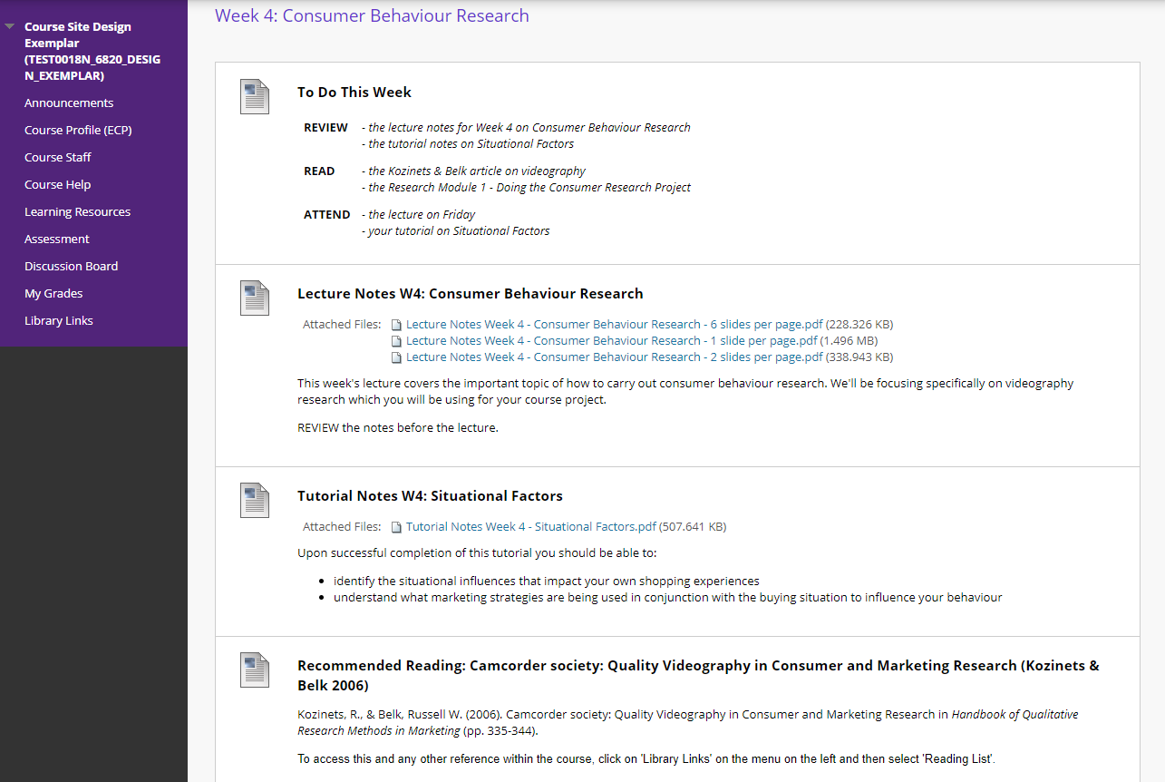
Overview of actions for the week
Lecture notes with indicative content
Tutorial notes labelled by week
Article reference & Library Link NOT pdf
No dates in file names
Notes:
If we now look within the week 2 folder, we can see all of the content on the topic of Individual Decision-making.
[CLICK] There are lecture notes with an indication about what the content of the lecture is,
[CLICK] articles to read with references and library links. There shouldn’t be PDF’s to articles for copyright reasons. Instead, provide your reading references to the library, and they will ensure that the course’s Library Links are kept up to date.
[CLICK] Importantly, there are no dates in the file names to avoid them having to be changed every time the course is run.
[CLICK] At the top there is a table of activities for the week followed by the resources required to guide students as to where they should focus their efforts.
[CLICK] And finally, the tutorial notes are labelled by topic and the week they are held, rather than number of the tutorial, to minimise confusion.

Slide 7
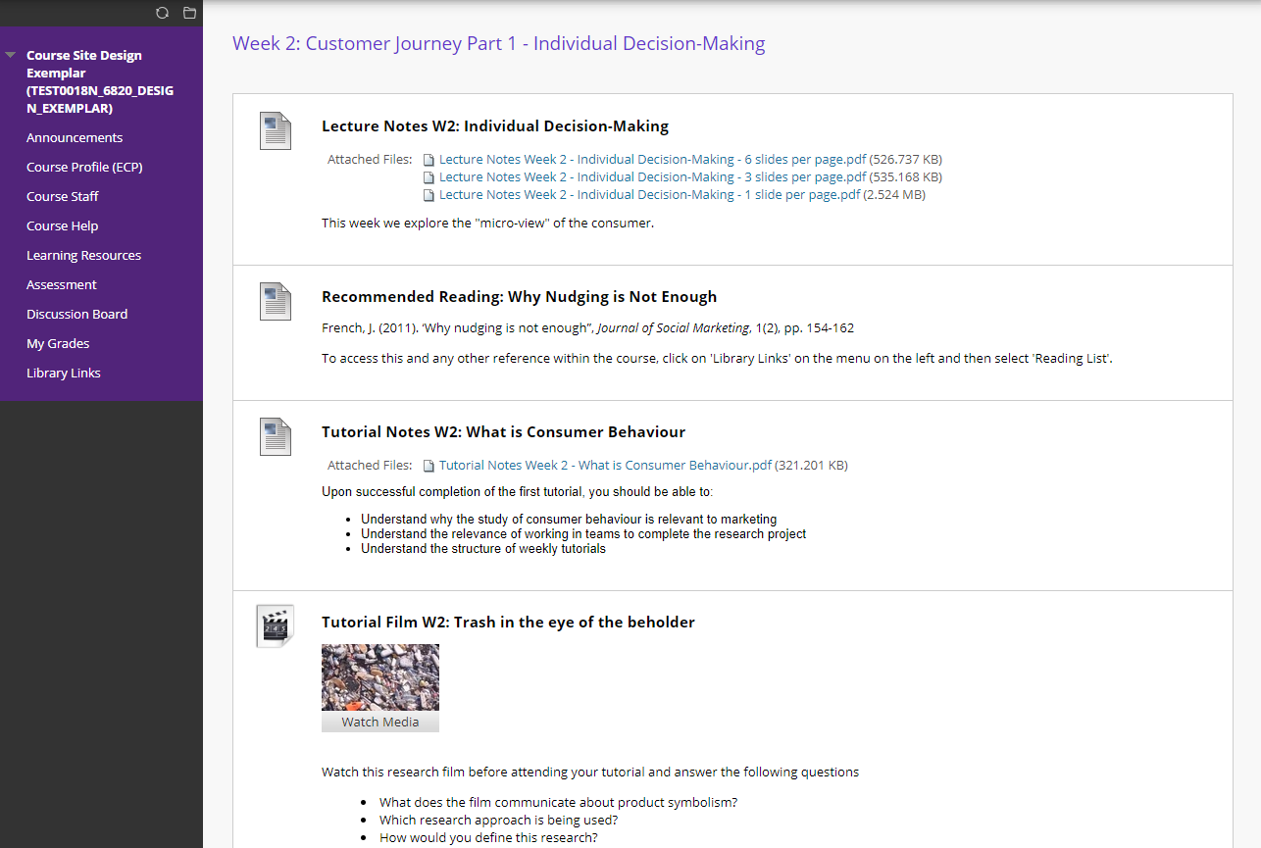
Titles include Week number
Content in a consistent & logical order
File name consistent with item title
Direction on what to do with content
Embedded multimedia content
Notes:
Further down the page in this folder, there are tutorial materials
[CLICK] There should also be directions on what students are expected to with the content.
[CLICK] Importantly, each week the content is in a consistent and logical order to make it as easy as possible for students to find.
[CLICK] The titles of the items include the week number
[CLICK] and the names of the attached files are consistent with the item titles.
[CLICK] There can also be embedded multimedia content to provide students with a more varied and engaging online experience.

Slide 8
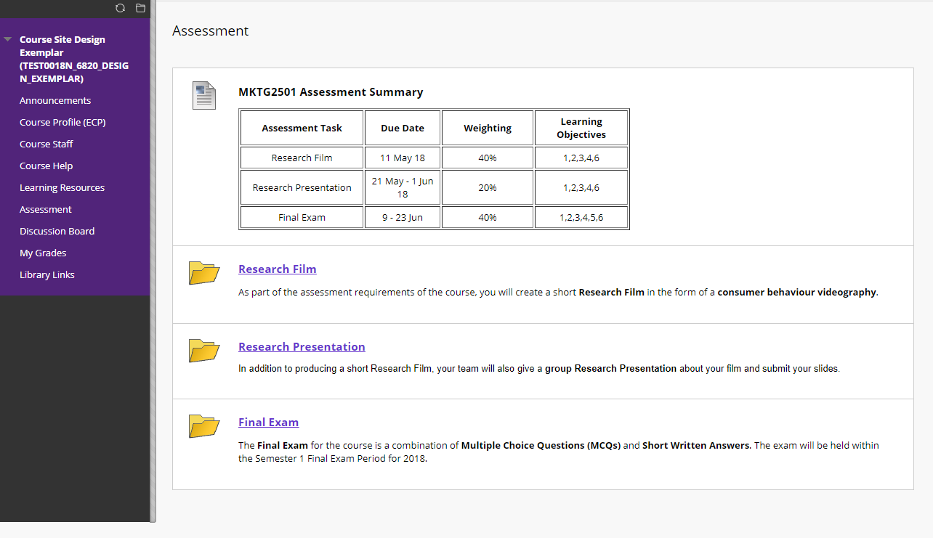
Screenshot from ECP for consistency
Titles identical to those in ECP
Folder contains everything required for assessment item
Separate folder for each assessment item
Notes:
The Assessment section content is headed with a summary of the assessment items for the course.
[CLICK] For consistency, this is a screenshot from the relevant section of the ECP.
[CLICK] Below the table, each assessment item has its own separate folder.
[CLICK] The titles of the folders are identical to those of the ECP,
[CLICK] and each folder contains everything required for the assessment item.

Slide 9
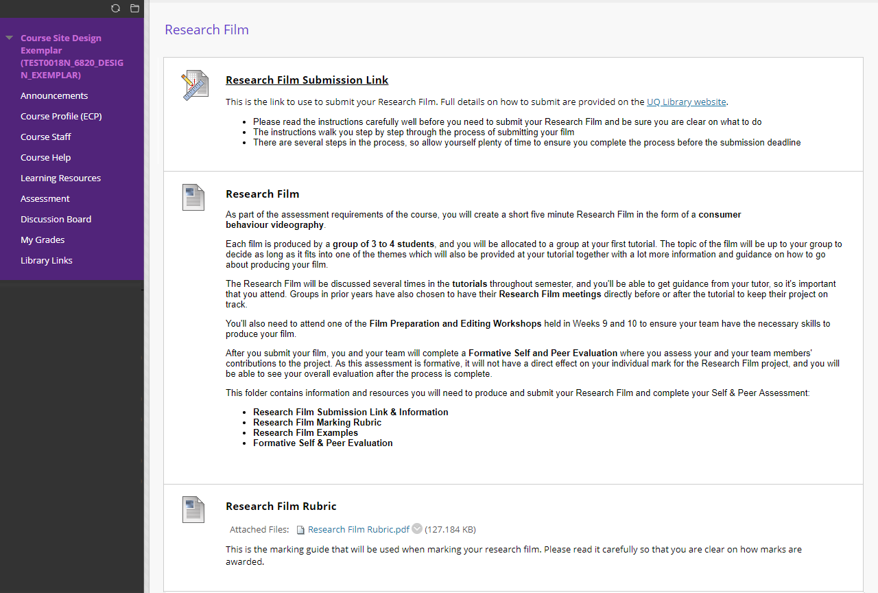
Submission link at the top
Link to library submission instructions
Submission instructions in each assessment item folder
Assessment item details or ECP reference
Marking rubric or reference to ECP as appropriate
Notes:
Looking into the assessment item folder for the Research Film,
[CLICK] the submission link is always at the top
[CLICK] together with instructions on how to submit that particular assessment item.
[CLICK] There are also details of the item which should be a reference to the relevant section of the ECP if possible.
[CLICK] Finally, there is the marketing rubric, or again a reference to the ECP as appropriate. The main aim of linking is to avoid duplicating content that is available elsewhere.
[CLICK] If there are school or library submission instructions, you can link to those directly for consistency and to avoid content replication

Slide 10
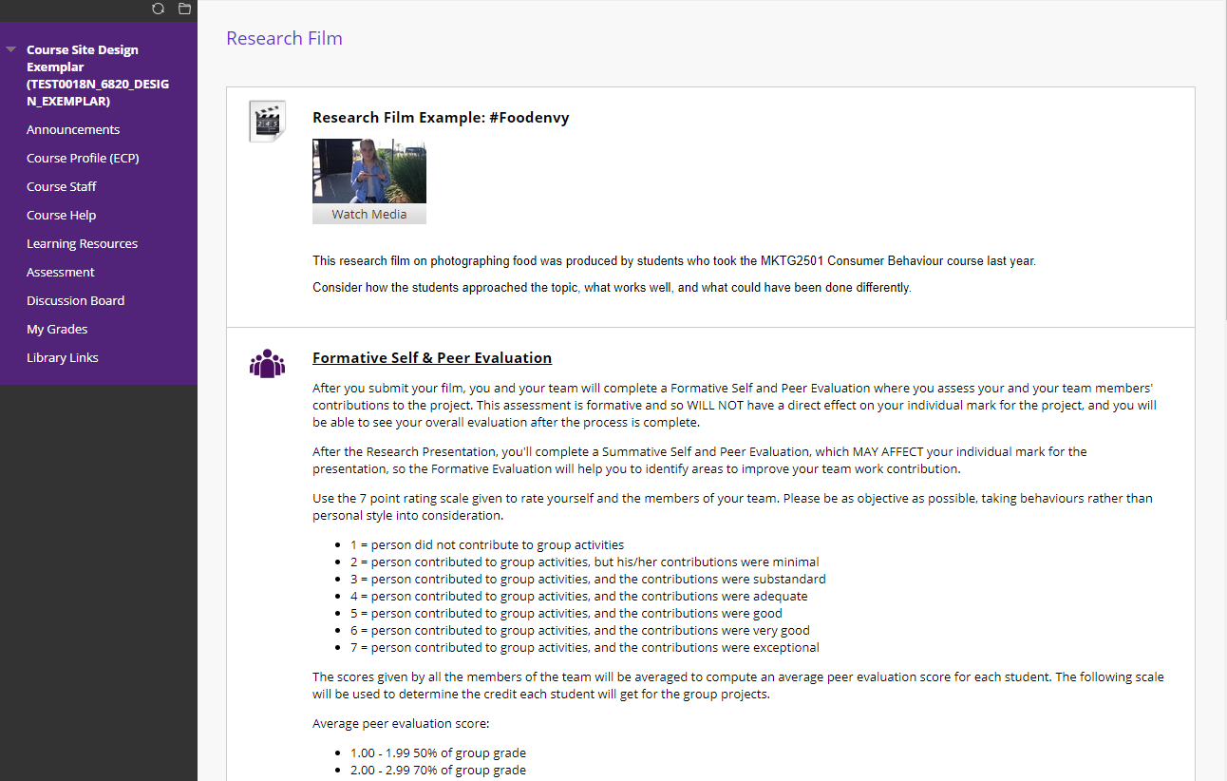
Assessment item exemplar
Link & instructions for Self & Peer Evaluation
Notes:
[CLICK] An assessment item exemplar is valuable for providing students with a high quality example of what they are expected to submit and help minimise basic questions about the assignment.
[CLICK] All components, including Self and Peer Evaluation links and instructions, for example, should be placed within the assessment item folder to allow students to see all aspects of the assignment within one folder.

Slide 11
Please review your course(s) against these guidelines

