Slide 1
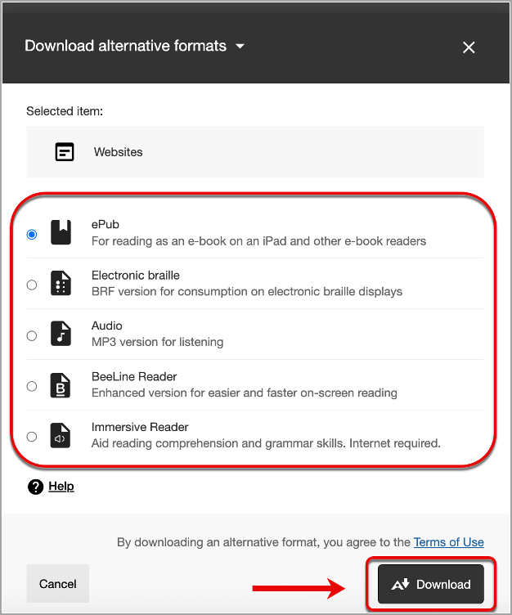

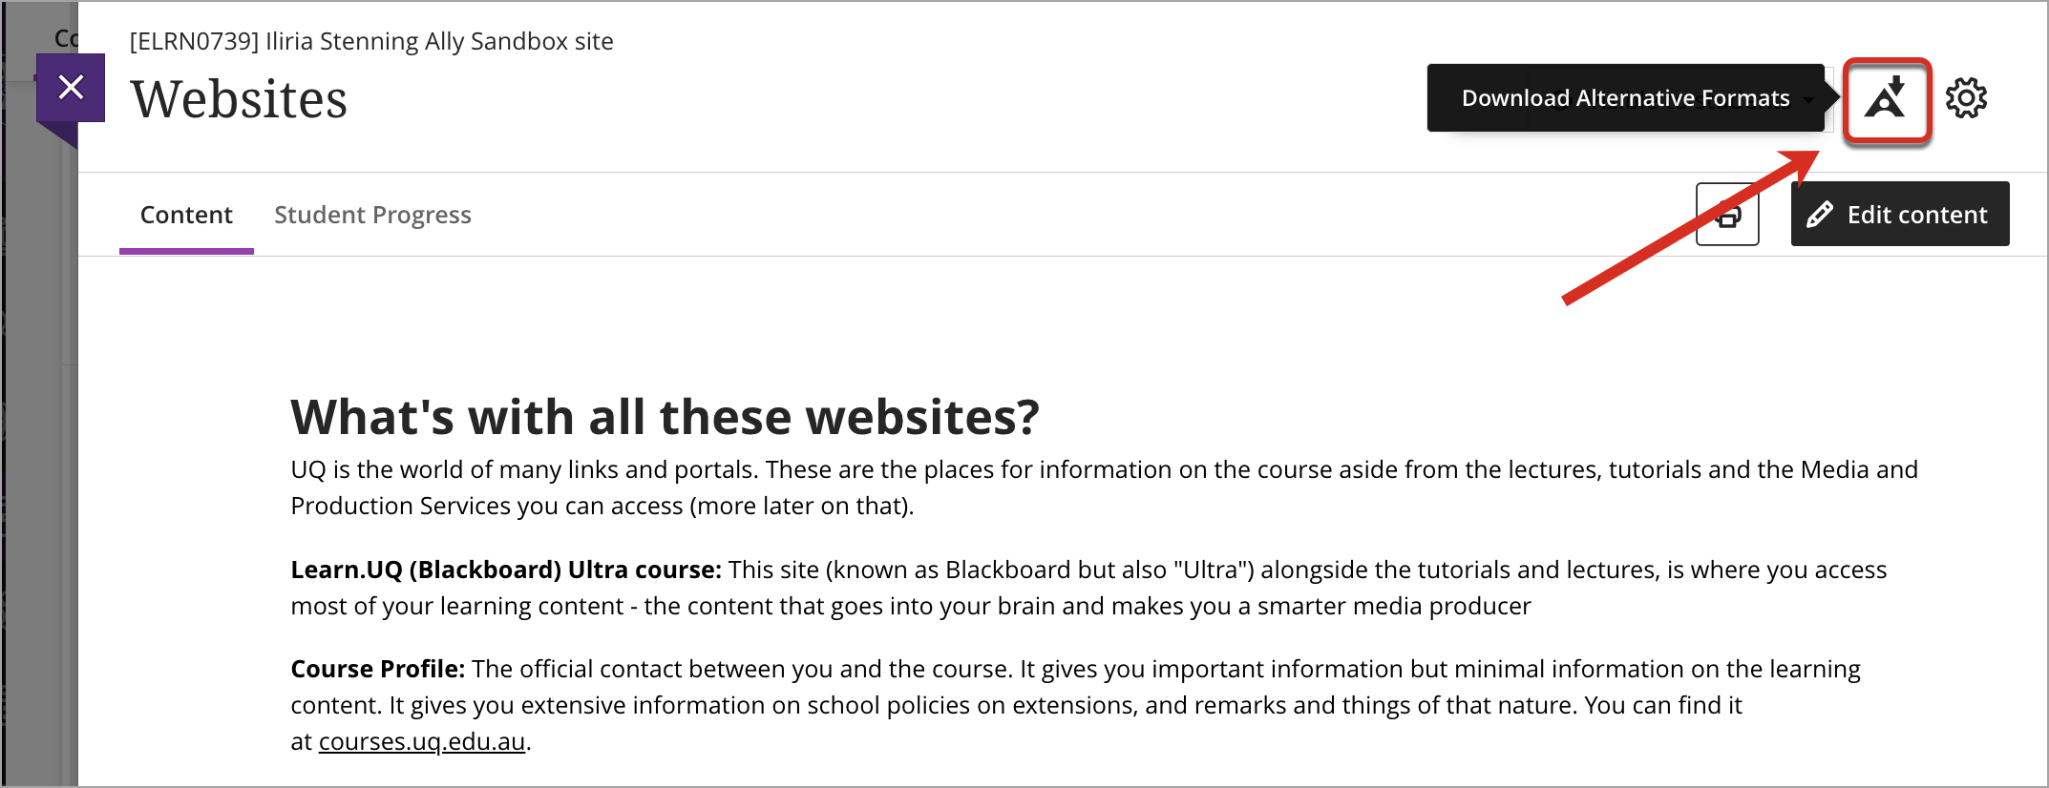
Alternative formats for course content
Students can use the Alternative Formats tool to automatically generate different versions of course content, enabling you to access the materials in the way that best supports your learning.
An A icon will display next to links and/or in the top right of course documents. When clicked, it provides you with a choice of automatically generated alternative formats.

Slide 2









Alternative accessible formats
Immersive Reader
Beeline Reader
OCRed PDF
Aid reading comprehension and grammar skills. Internet required.
Enhanced version for faster and more focused on-screen reading.
Makes scanned documents searchable and more readable. Reduces file size.
Tagged PDF
Audio
ePub
Structured PDF for improved use with assistive technology.
MP3 version for listening on personal devices and in more contexts.
For reading as an e-book on an iPad and other e-book readers.
Electronic braille
HTML
BRF version for consumption on electronic braille displays.
For viewing in the browser and on mobile devices.
Look out for the Alternative formats icon

