Slide 1
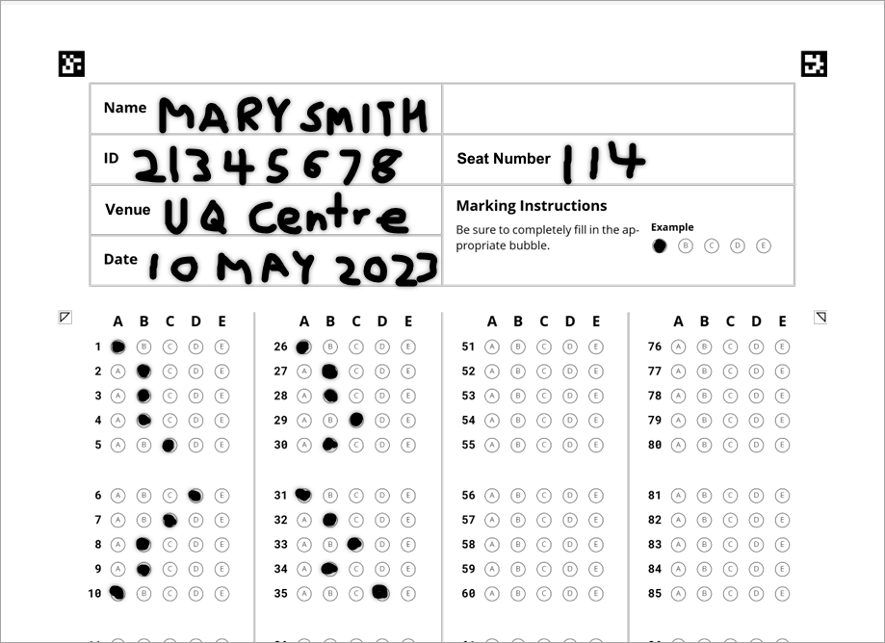
Gradescope Bubble Sheet tips
1. Your exam will use a Gradescope Bubble Sheet
2. Enter your FIRST NAME & LAST NAME in block capitals
3. Enter your eight digit UQ student ID
5. Enter the date of your exam
6. Fill in the bubbles using a 2B pencil
7. To change an answer use an eraser
4. For central exams enter the venue and your seat number
Notes:
There are two bubble sheet templates:
the original template used with the ITS machine marking service
this template used with Gradescope
WARNING: You cannot use the original template with Gradescope (or vice versa)
When submitting your exam request to Examinations you can choose between the two options.

